Slide 1
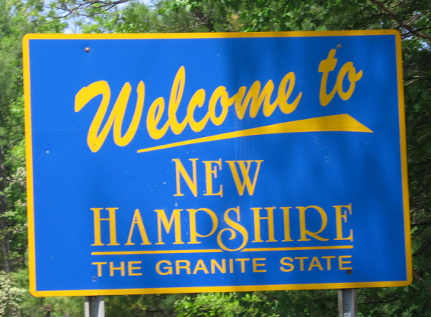
New Hampshire Traffic Stops 2014-2015
Jared, Jon, Manoj, & Jessica

Slide 2
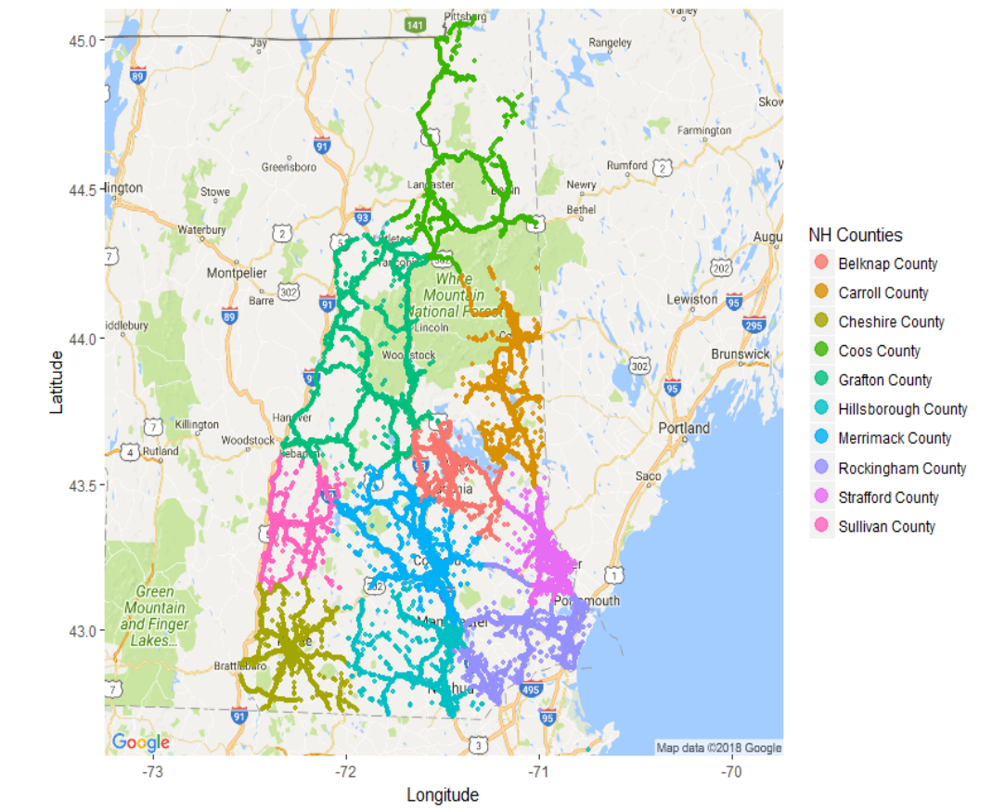

Slide 3

Impact of Weather on Traffic Stops

Slide 4
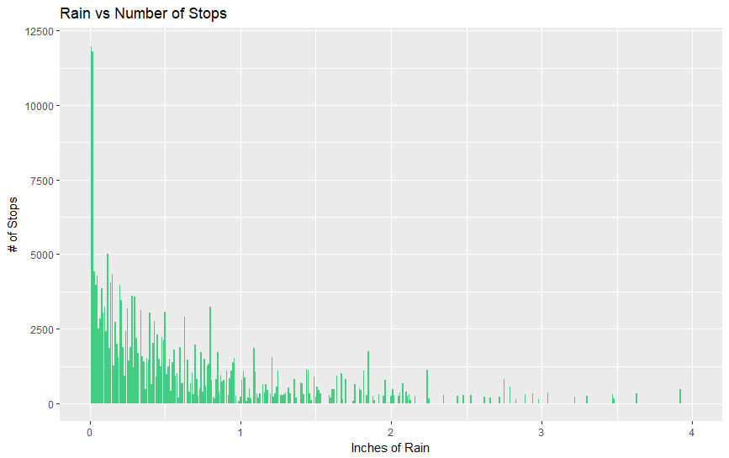

Slide 5
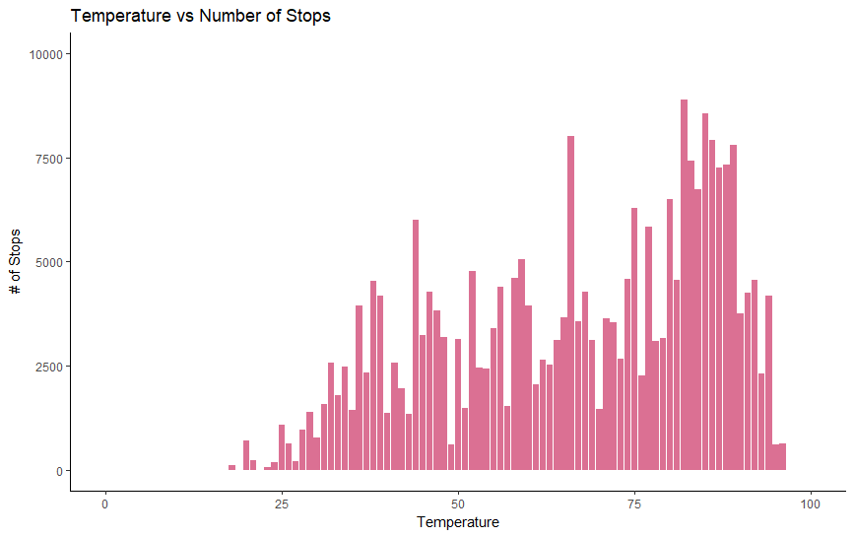

Slide 6
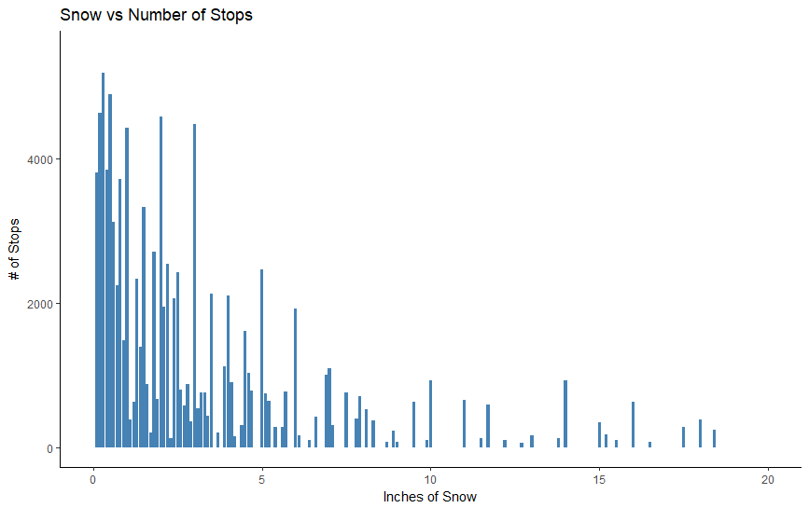

Slide 7
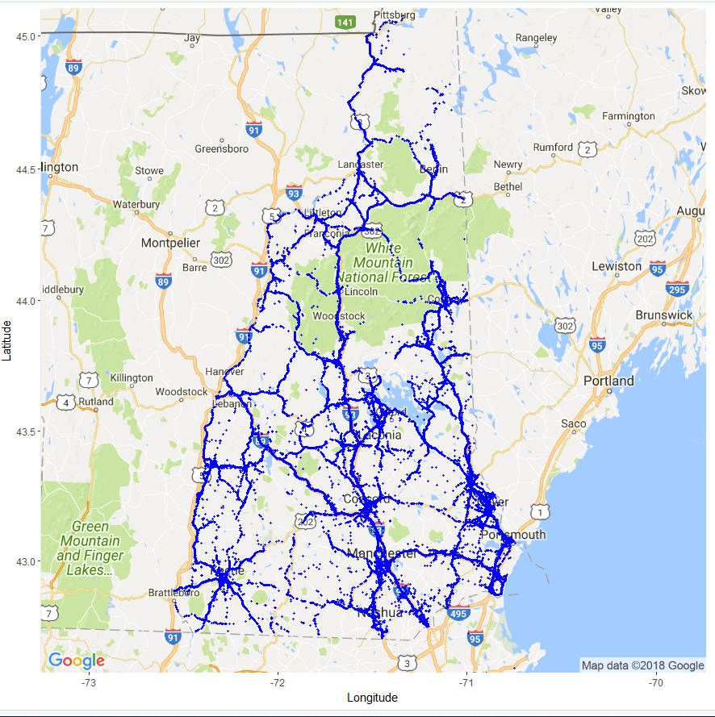
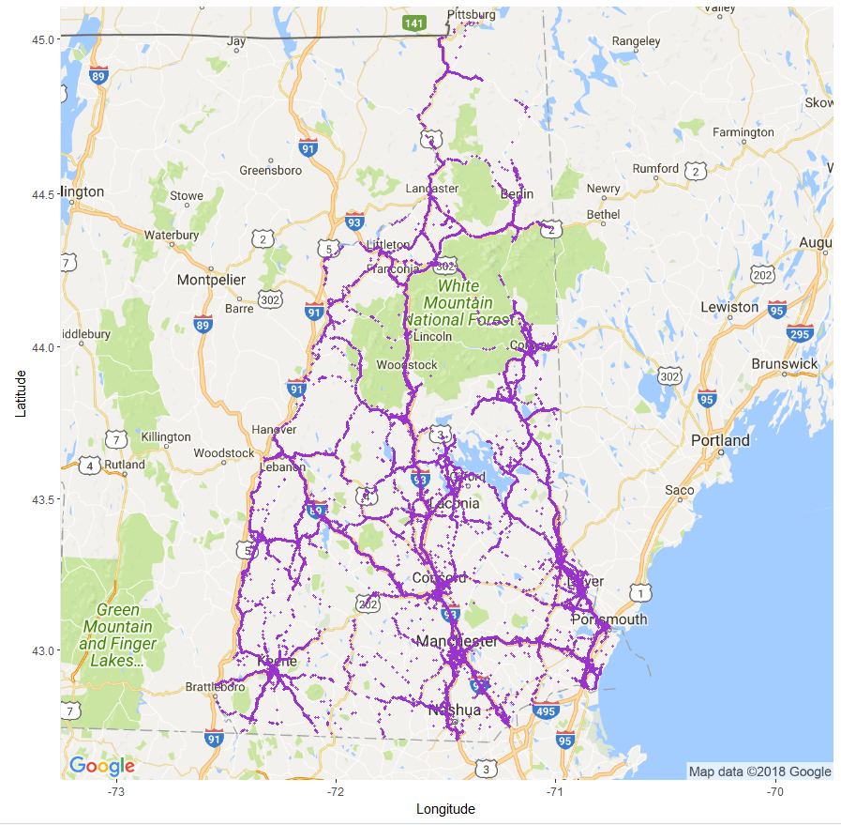
MALES ONLY
FEMALES ONLY

Slide 8
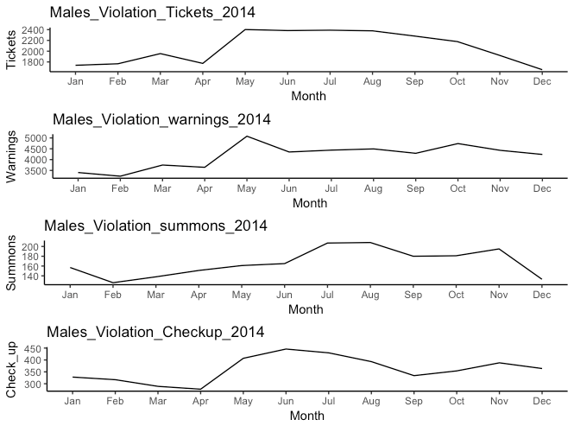
2014 Stop Outcomes for Males

Slide 9
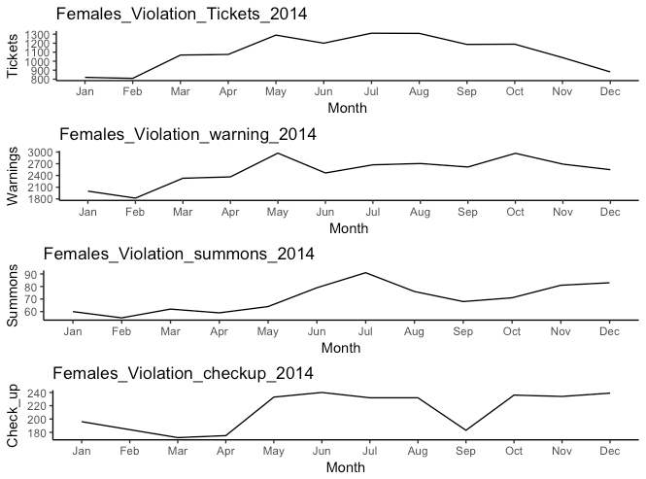
2014 Stop Outcomes Females

Slide 10
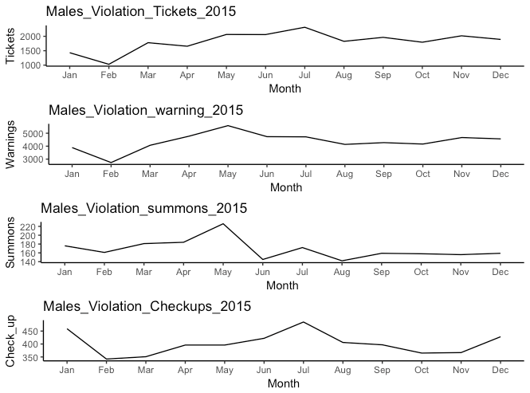
2015 Stop Outcome Males

Slide 11
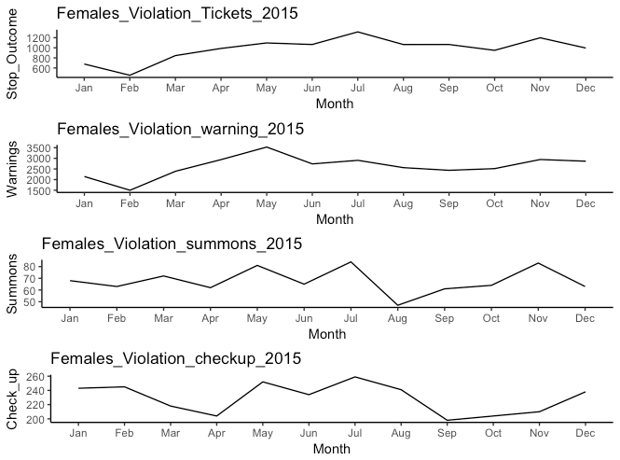
2015 Stop Outcomes Females

Slide 12
NH cops say they’re told to hit traffic ticket quotas
March 27, 2018 Portsmouth Herald
Portsmouth police union filed a grievance claiming city officers are working under a quota mandate for writing traffic tickets.
Police officials have denied the allegation.
Police union signed a new contract in September 2016 that included a provision mandating they receive performance evaluations.
Two officers were “negatively impacted” on their evaluations for failing to meet certain “established benchmarks or quota.”
The union claims police management had thus established a “de facto quota system,”

Slide 13
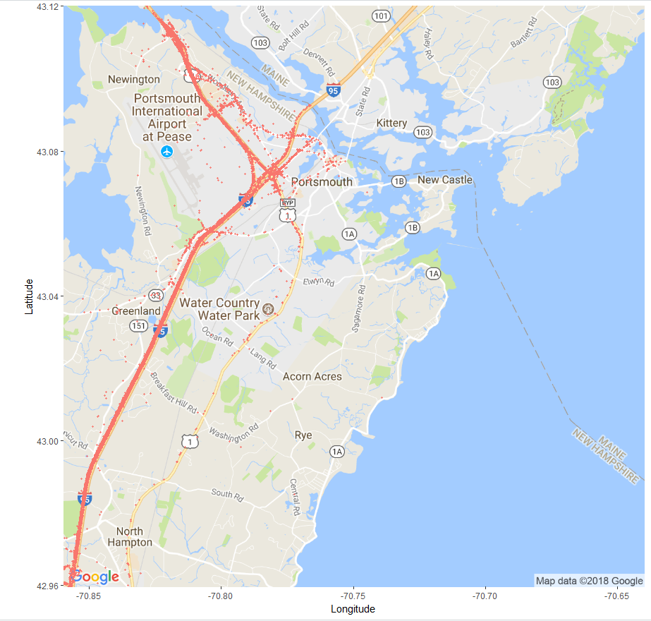
Portsmouth Area
Traffic Stops

Slide 14
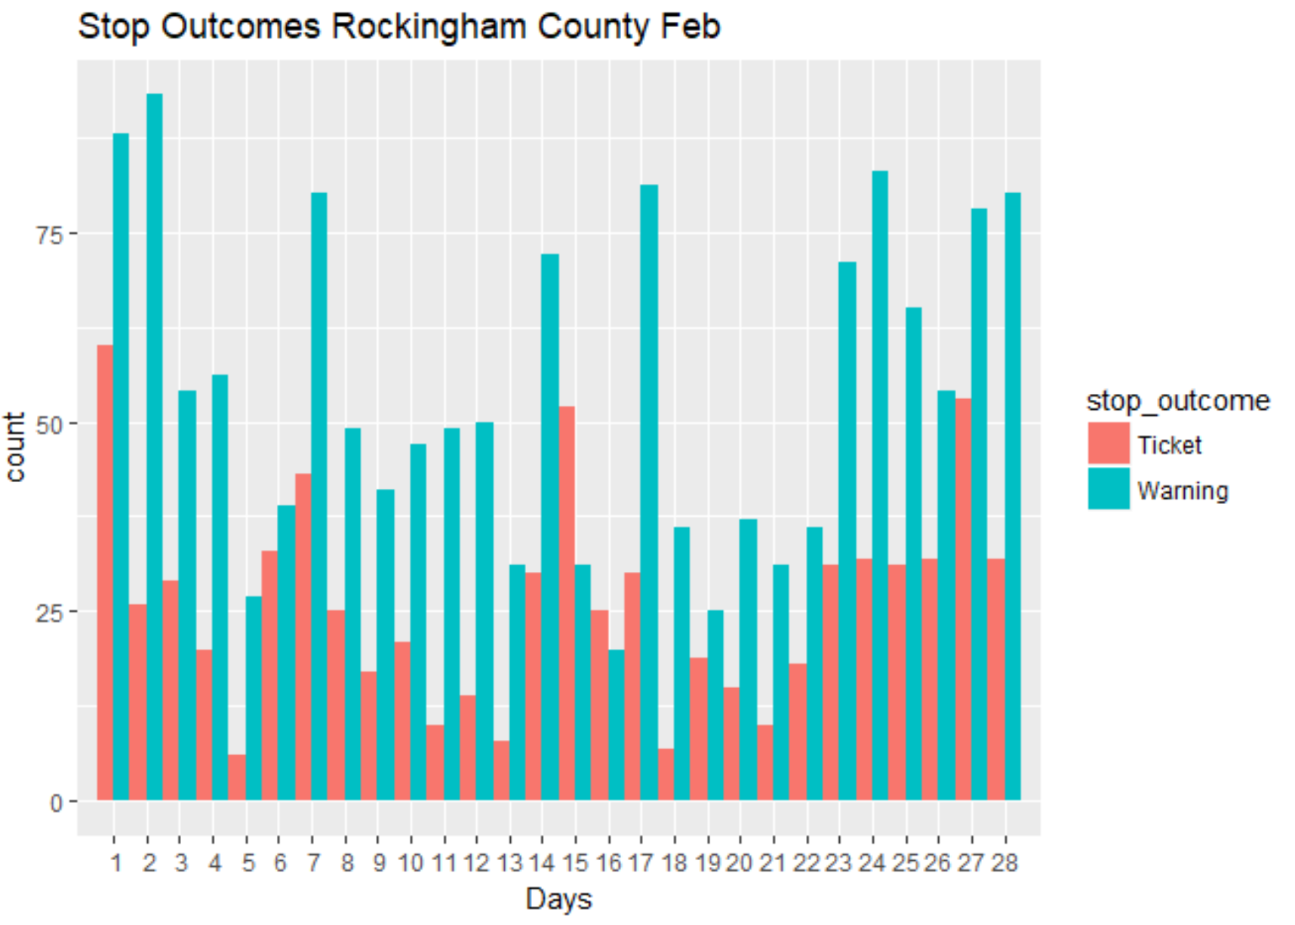

Slide 15
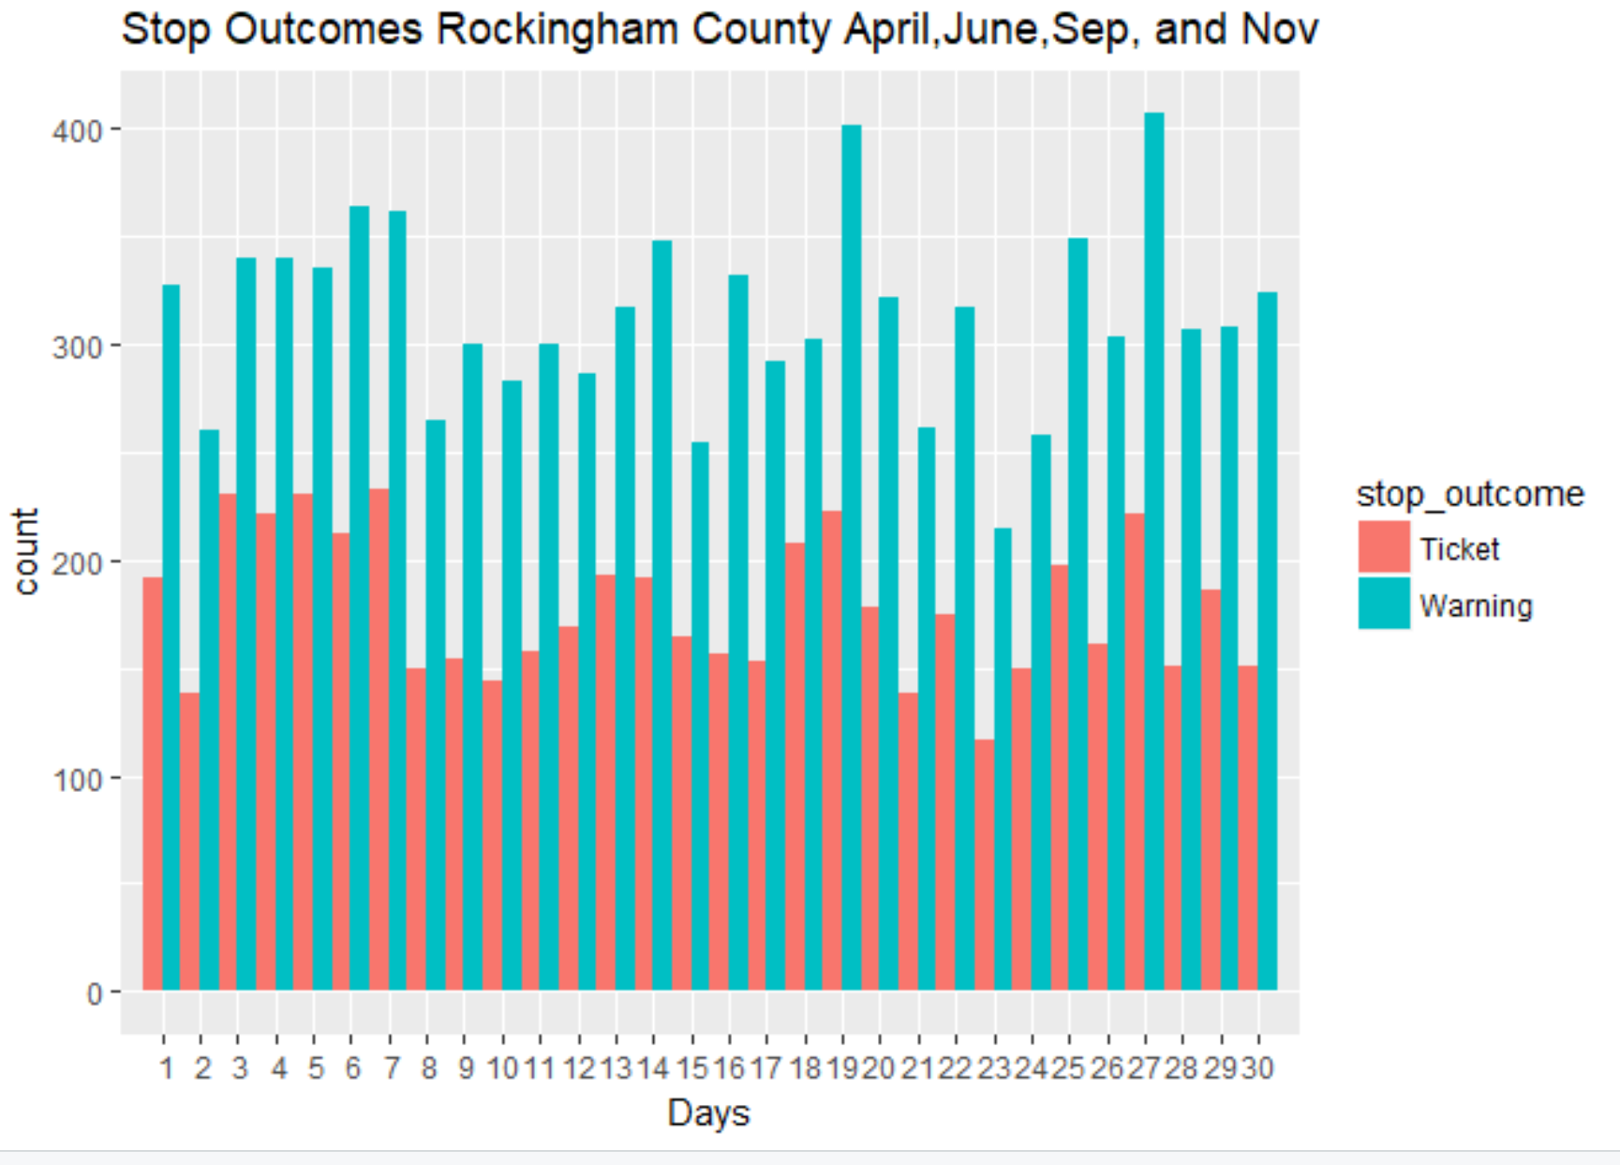

Slide 16
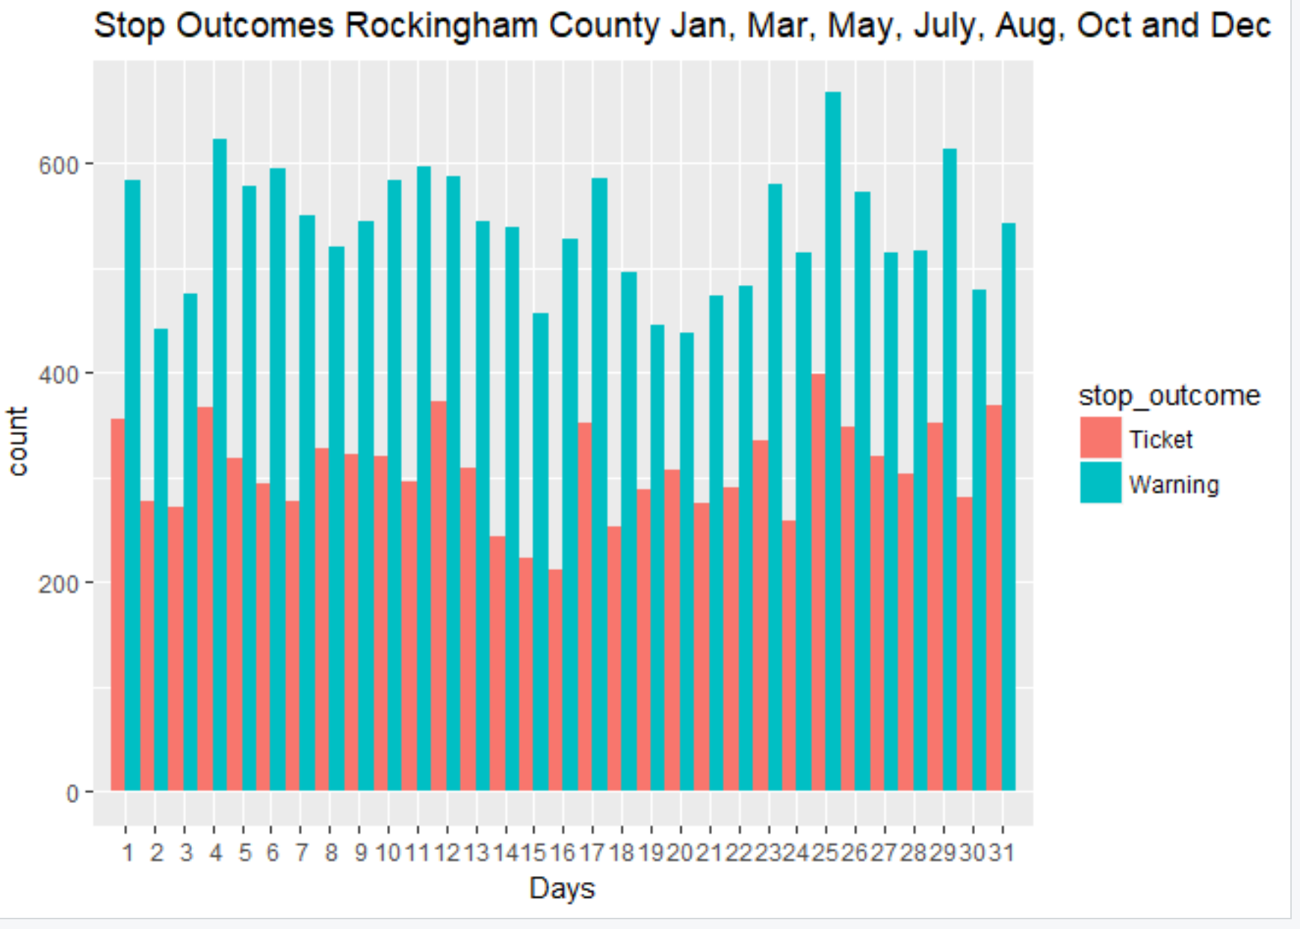

Slide 17
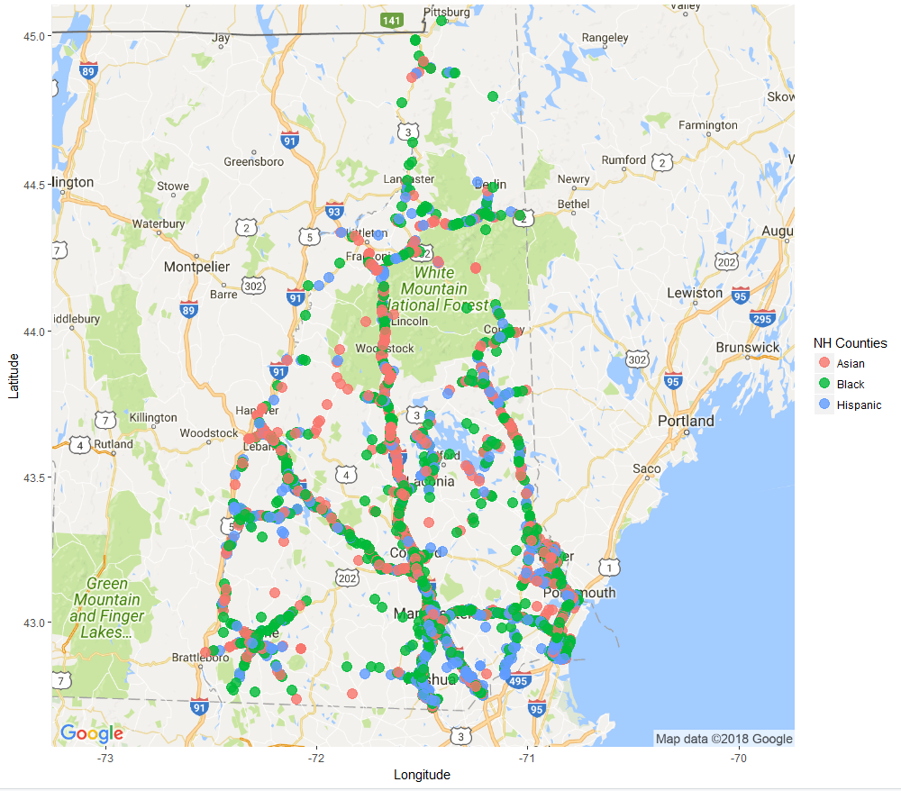
Non-White Driver
Traffic Stops

Slide 18
